Slide 1
Inversion of control
Tony Rasa – BSDG Presents

Slide 2
Concepts
IoC is the tip of a complicated architectural iceburg
Back to fundamentals
More than just tools

Slide 3
Design Goals
Make code easier to work with.
Modify, Extend, Debug, Whatever.
Make code easier to test.
Make code easier to understand.
Simply reading it explains what’s going on.

Slide 4
But lets talk about IoC
Simple Definition…

Slide 5
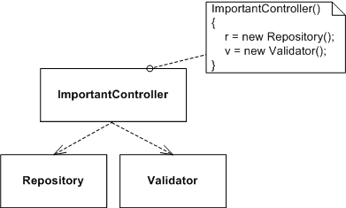
Control (Simplified Definition)

Slide 6
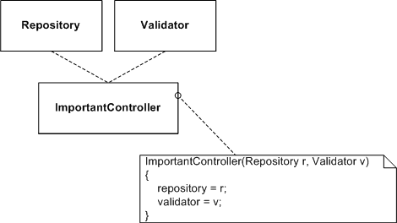
Control, Inverted.

Slide 7
Any Questions?

Slide 8
Principles
Separation of Concerns
Single Responsibility Principle
Liskov Substitution Principle

Slide 9
Separation of Concerns
SuperController – has all Repository and Validation functionality built in.
Example Concerns:
Data Access, Validation

Slide 10
Single Responsibility Principle
Every object should have a single responsibility.
Responsibility = “Reason to Change”
Every class has only one reason to change.
Anti-Example: SuperController

Slide 11
SRP Consequences
Lots of Smaller Classes
Smaller Classes = Simpler Classes
Simpler Classes = Easier To Test
Fewer Dependencies
Easier To Test = Easier To Verify
There is very little penalty for having a lot of small, simple classes.

Slide 12
IoC Benefits
IoC provides benefits when
Structure has Separation of Concerns
Classes follow SRP

Slide 13
Liskov Substitution Principle
If ChildClass inherits from BaseClass, then wherever I use a BaseClass reference, I could substitute a ChildClass reference without any problems.
Develop against Interfaces
IRepository, not SqlRepository
IDataRecord, not SqlDataReader

Slide 14

Substitutable Dependencies

Slide 15
Substitutable Dependencies
I don’t care what, exactly, IRepository is
I can substitute anything that is IRepository-like, and it’ll be fine.
I don’t even care where that IRepository-like thing came from.
As long as it is substitutable for IRepository.

Slide 16
IoC
IoC Techniques and Frameworks DEPEND on Liskov Substitution Principle
So do good OO practices

Slide 17
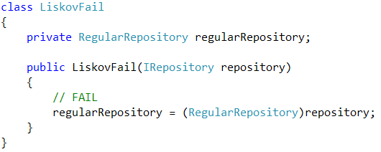
Liskov FAIL

Slide 18
Tools
All this injection is a lot of work, use tools to do auto-wiring for you:
Castle Windsor
Spring.NET
StructureMap
Unity

Slide 19
Windsor Configuration
Declare your services and dependencies.
Windsor glues everything together.
If Windsor knows A, and B
And C needs A and B,
Windsor can build C too.

Slide 20
Windsor Configuration
Declaration can be
Xml
Fluent
Boo

Slide 21
Your Questions
Tony Rasa | Blackfin
trasa@meancat.com
elegantcode.com

